Slide 1








MEET THE TEAM
Early Years – Reception
Fairytale One Phase
Sunnyside Class

Slide 2

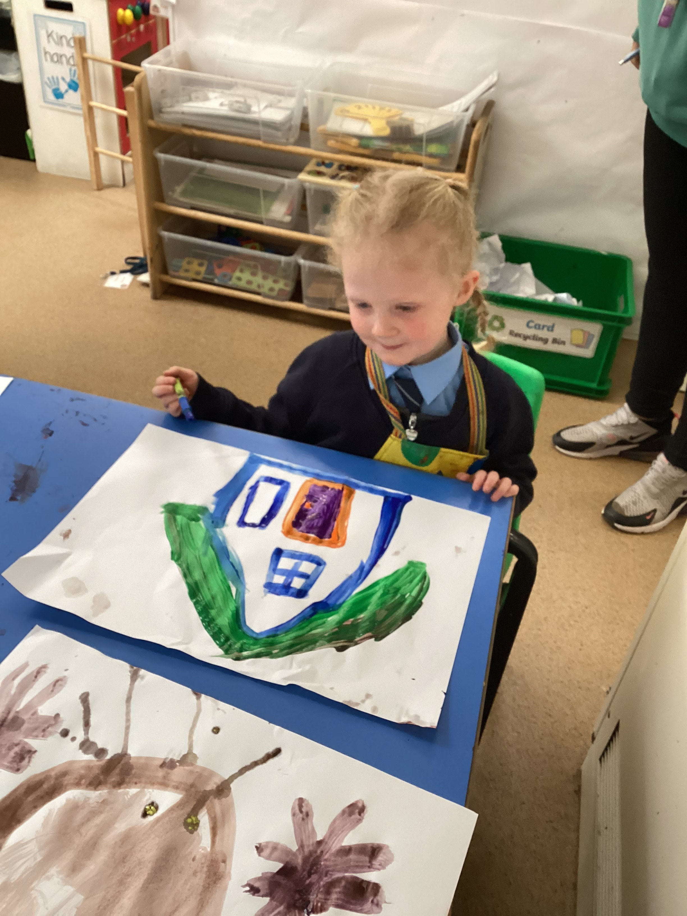
Early Years Staff Team
Reception Team
Jo O’Neill
Eve Radzik
Alisha Vassell

Slide 3
Uniform
P.E Kit
Navy, grey or black skirt, trousers or pinafore, (shorts in summer) blue summer dress
Blue shirt
Tie
Navy cardigan or jumper
Black shoes
White top
Blue or black shorts
Blue or black joggers and jacket or jumper
Trainers
Socks if girls are wearing tights in winter.
Please can all uniform and P.E kit be clearly named.
P.E kit can be kept in school for half term.

Slide 4





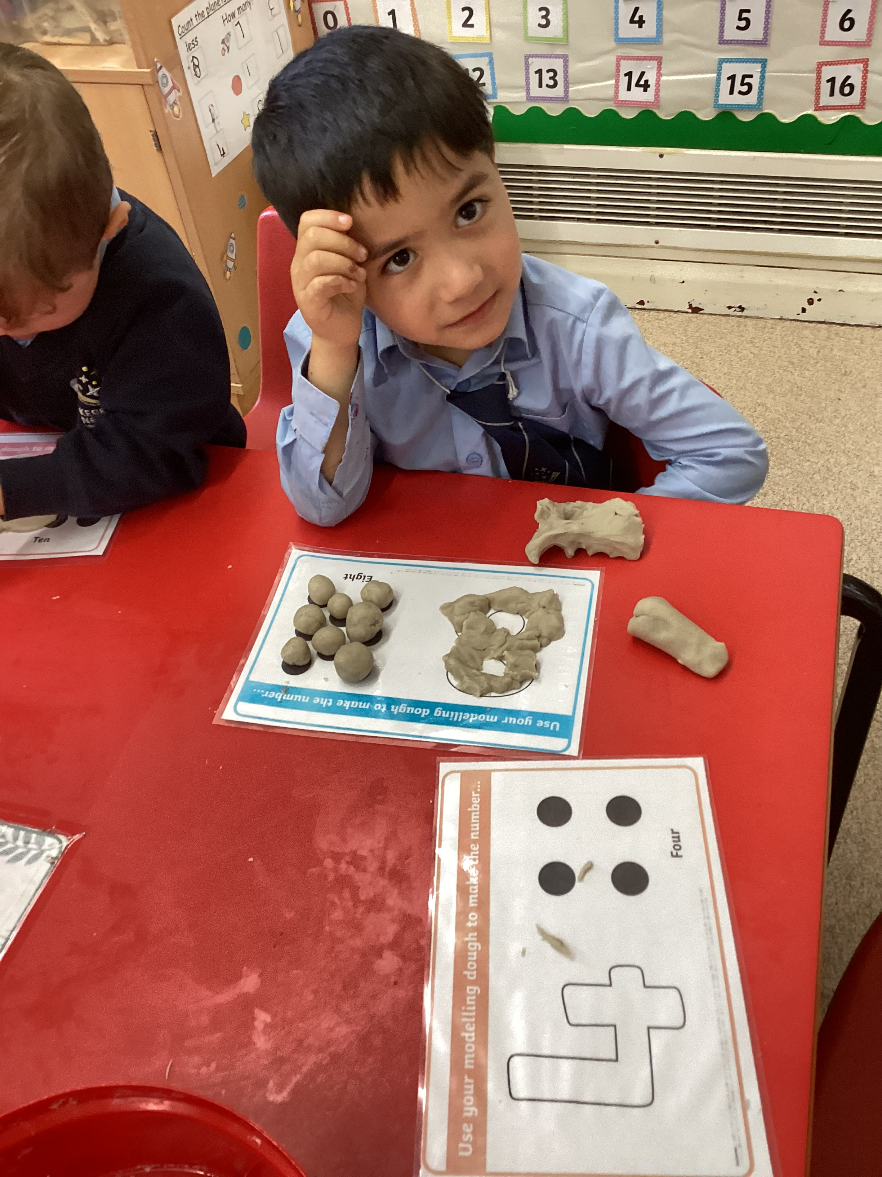

The school day
Reception
Gates open 8.40am – 8.50am
Registration 8.50am – 8.55am
Morning Learning 8.55am – 12.00am
Lunch Break 12.00am – 1.00pm
Afternoon Learning 1pm - 3.20pm

Slide 5


Early Years Learning

Slide 6
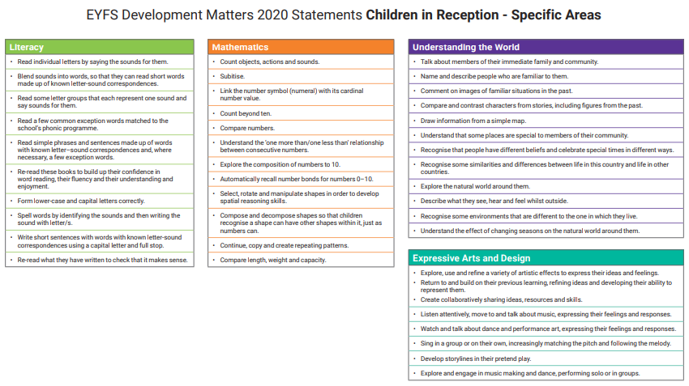

Early Years Learning – Reception

Slide 7
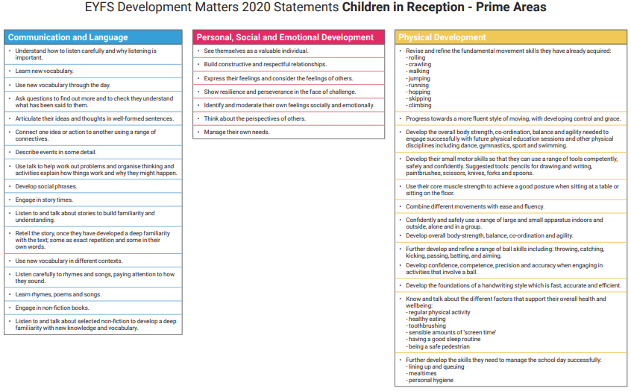
Early Years Learning – Reception

Slide 8
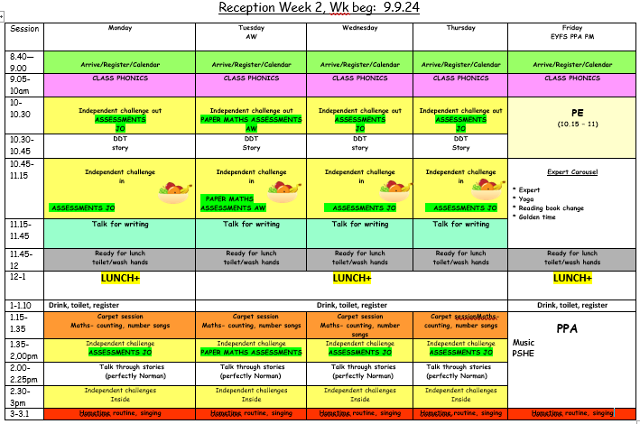

Timetable – Reception

Slide 9
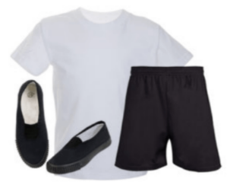
PE
Children have PE sessions led by their teachers,
which help them to achieve the physical
development early learning goals.
Skills taught include:
Balancing
Ball skills
Running, stopping and command games
Gymnastics
Jumping
Throwing and catching (Target games)
Games - athletics
Additional Yoga sessions and Partner Games support the children in their movement and Team building development.

Slide 10
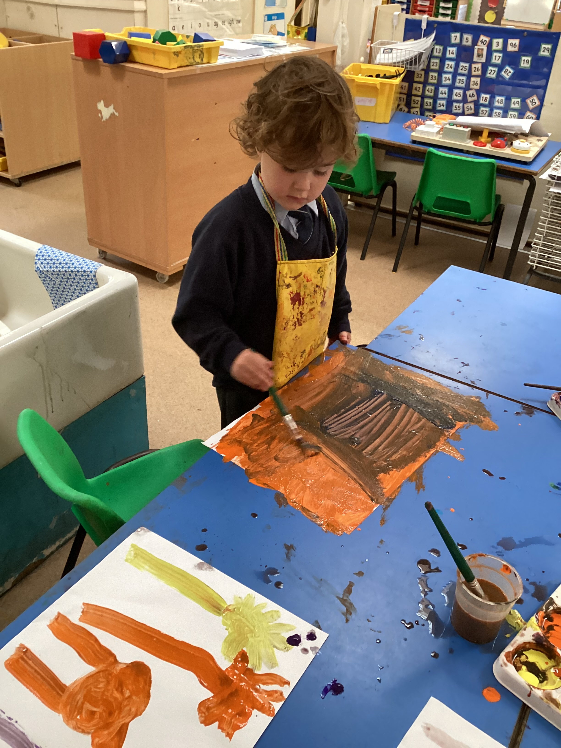

Experiences
We aim to enrich our curriculum with in school and out of school experiences.
Plans for this term:
Food Tasting – fruits and foods from different cultures
Autumn – Seasonal Stay and Play
Cooking – biscuit and cake decorating, cake making, vegetable soup
Open day
Theatre Trip – Warwick Arts Centre
Reception Nativity
Nursery Christmas Carols
Christmas fair
Christmas Stay and Play
Family bingo

Slide 11

How to help at home
Talk to your child about what they have been learning at school and what they notice of the world around them.
Share a story with your child everyday. Once they have words to read or a story, listen to them read them at least 4 times a week.
Help them to count and notice numbers wherever you go.
Ensure your child has a suitable bedtime, so they can be wide awake and ready to learn in school. Make time for them to have a healthy breakfast before coming to school.
Talk about the sounds you hear around you. Identify and name the source of sounds you hear. Make rhymes explicit. Talk about beginning sound e.g. play ‘I spy’

Slide 12


Reception Homework
Homework will be sent home every Friday.
Books need to be returned the following Wednesday.(For marking and so that the next task can be added.)
Please encourage your child to look after their homework book.
Your time and commitment to support and encourage your child with their homework will have a massive impact on their learning and progress.
We value our home-school partnership greatly. Thank you in advance.

Slide 13
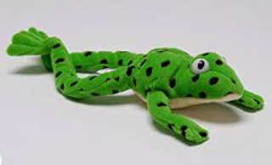

Reception Home Reading
Bedtime Reading
Sharing stories at bedtime is a great way to support your child to relax and spark your child’s love of stories.
Talk about what they heard and likes and dislikes.
We have books you can loan to widen your collection!
Books from school
Reception
Set 1 sound books
Read Write Inc Books
Reading for confidence book to share
.
We will send further support ideas as the year progresses.

Slide 14

PTA
If you are interested in being part of our PTA, please see Mrs Penlington to express your interest.

