Slide 1







Welcome to
Year 5 and 6

Slide 2

Fantasy Phase Staff team
Teaching Staff
Mrs Craft- Y5
Mrs Sian- Y6
Support staff
Mrs Howarth
Miss Molawka
Miss Hardy

Slide 3
Uniform
AN IMPORTANT PART OF “RESPECT OURSELVES”
Navy, grey or black skirt, trousers or pinafore (shorts in summer/checked summer dress)
Blue shirt
Tie
Navy cardigan or jumper
Black shoes (not trainers)
Please do not send your child in wearing jewellery

Slide 4
The school day
Gates open 8.40am – 8.55am
Registration 8.55am – 9am
Morning Learning 9am – 12.15pm
Lunch Break 12:15pm – 1:15pm
Afternoon Learning 1:15-3.20pm

Slide 5
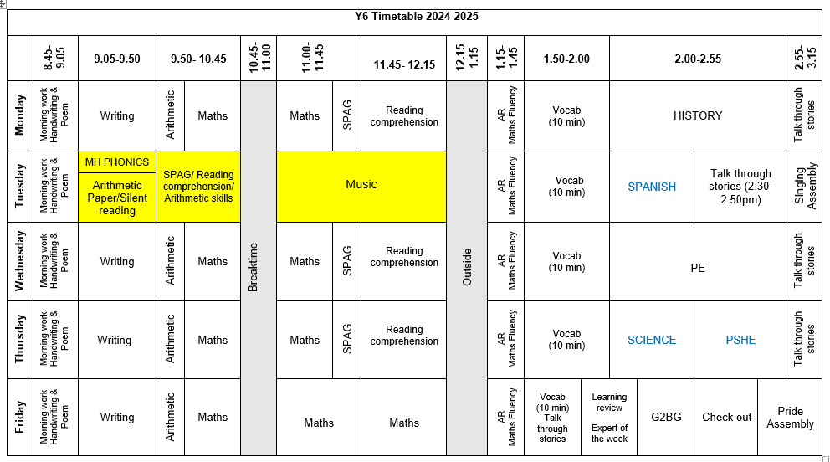
Timetable- Keresley Newland

Slide 6

Fantasy phase learning
We are writing a ‘Beating the Monster’ tale in our Talk for Writing unit. Our writing is based on the traditional tale of Jack and the Beanstalk. We are learning our story using our story maps and completing short bursts of writing practising different writing techniques such as personification and fronted adverbials.
We are using the Talk through Stories approach to develop our understanding of storytelling and vocabulary through the use of rich texts and class readers.
In reading fluency- Children are learning the components of being a fluent reader through the use of ECHO reading and comprehension based tasks.
In Maths, we will begin our learning with Place Value by building on what we already know about numbers. This will be a good foundation for when we move on to the four operations before tackling Fractions before Christmas.
Our History topic this term is the VIKINGS. We are learning about how the Vikings came to Britain and understanding the importance they had in our history. We are using our historical enquiry skills to look at sources and artefacts.
In our Expert Science lessons, Year 5 are learning about Materials: Mixtures and Separation and Year 6 are learning about Living things: classifying big and small.

Slide 7
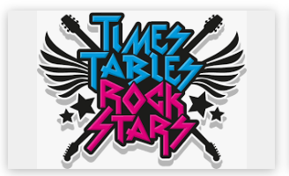
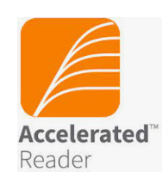
Homework
Homework will be reviewed with children and re-set every Wednesday.
Homework will be either in paper form or online based homework.
Your time and commitment to support and encourage your child with their homework will have a massive impact on their learning and progress.
We value our home-school partnership greatly.
Children will be provided with logins for TTRockstars, Spelling Shed, Duolingo, SATS companion and AR which they can access in school and at home to support their learning.

Slide 8
Home Reading
Bedtime Reading
Sharing stories at bedtime is a great way to support your child to relax and spark your child’s love of reading.
Older children still love being read to.
Try to listen to them read at least 4 times a week.
Talk about what the characters feel and think.
Books from school
Children have completed their Star Reader tests and been allocated a book matched to their reading age.
They read these at school and can bring them home.
Please remember to return each day though.
Your child is also encouraged to read books that they have at home. Just get them to check it is on AR so it boosts their word count.

Slide 9
PE
PE sessions will be led by the Y5/6 staff.
Skills taught include:
Balancing
Ball skills
Running, stopping and command games
Gymnastics
Jumping
Throwing and catching (Target games)
Games – athletics
Football, basketball
Later in the year, your child may attend swimming.

Slide 10
PE kits
Dark plain jogging bottoms
Dark plain jumper
White t-shirt
Trainers
PE kits should stay in lockers for the whole half term. They will be sent home to wash at half term.
If you would like to wash the kit more regularly, children may bring home on a Friday but must return on a Monday.
Girls and boys change separately for PE.
If your child wears studded earrings, please ensure they can take them out themselves or don’t send them to school wearing earrings on PE days.

Slide 11
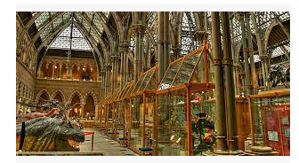
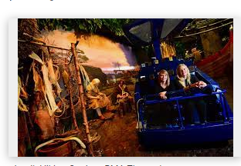
Educational visits
PGL- Y6 residential visit- Autumn Term
We will update this with trips as they happen in the year.

Slide 12
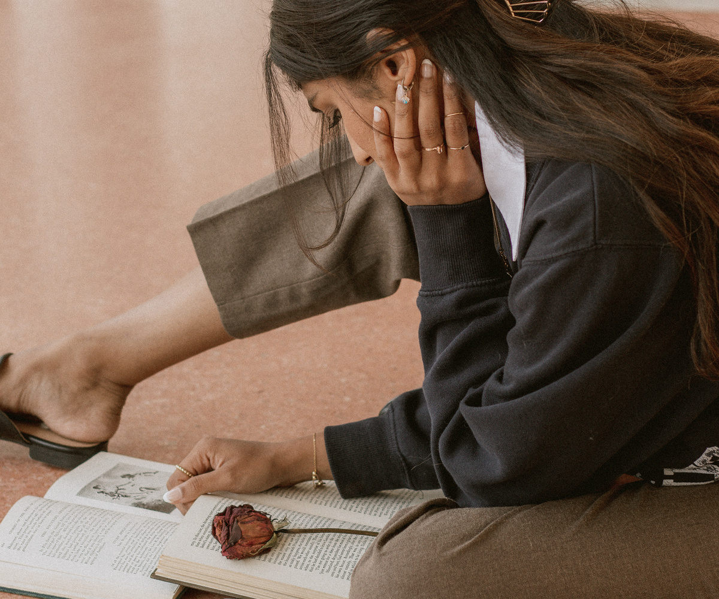

Key dates for the Autumn Term
Monday 30th September- 2nd October: PGL- Year 6 Residential Trip
Monday 18th November- 21st November: Y6 MOCK SATS
Tuesday 3rd December- Christmas Fayre
Monday 9th December: Year 5 at President Kennedy- Super Learning Maths
Friday 13th December- Upper KS2 Christmas Concert

Slide 13
How to help at home
Encourage your child to read everyday and listen to them read at least 4 times a week.
Practise times tables regularly.
Support your child to complete their homework. Ask them to check what is set each Friday.
Ensure your child has a suitable bedtime so they can be wide awake and ready to learn in school. Try to encourage them to have a healthy breakfast before coming to school.

Slide 14
How to contact us
If you have a query regarding any aspect of your child’s learning or emotional wellbeing then please contact your child’s class teacher. This can be done in person at the start or the end of the school day or via the class email.
kensukeskingdom@knpa.warwickshire.sch.uk
poetscorner@knpa.warwickshire.sch.uk
If you feel that a longer face to face meeting is needed then please contact the class teacher via email to arrange a mutually convenient appointment.

Slide 15
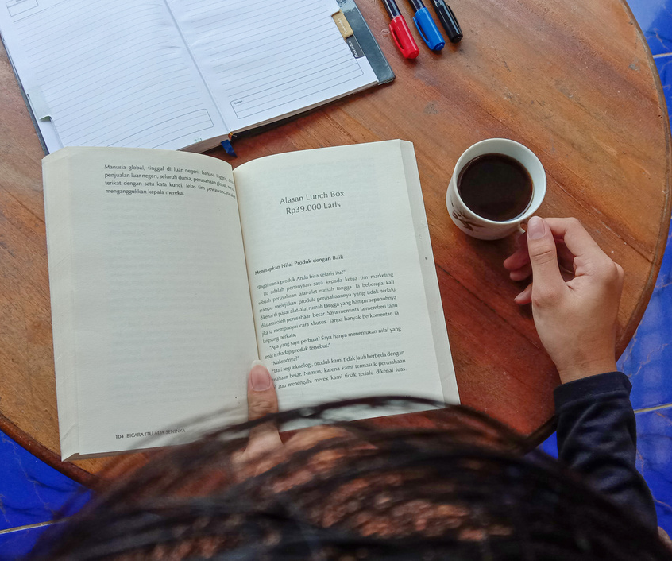

Y6
Please remember that the deadline for applications to secondary schools is Thursday 31st October 2024.
Y6 SATs will take place during the week of 12th May 2025. We will hold an information meeting for parents in January.

